Slide 1
Nomad Program Overview

Slide 2
Overview
Full Motion Video
Imaging System
Gimbal
Data Output
Wide Area Camera
Cameras
Control Capability
Communications

Slide 3
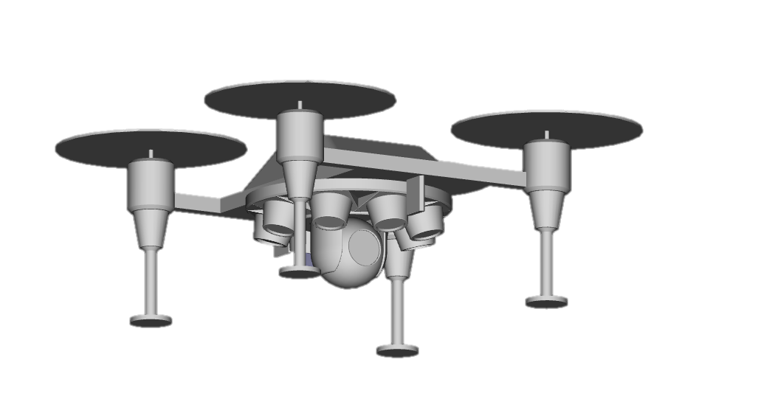
Overview
Mission Computer
Payload Comm Antenna
Bluefire Wide Area Camera System
Full Motion Video Gimbal

Slide 4
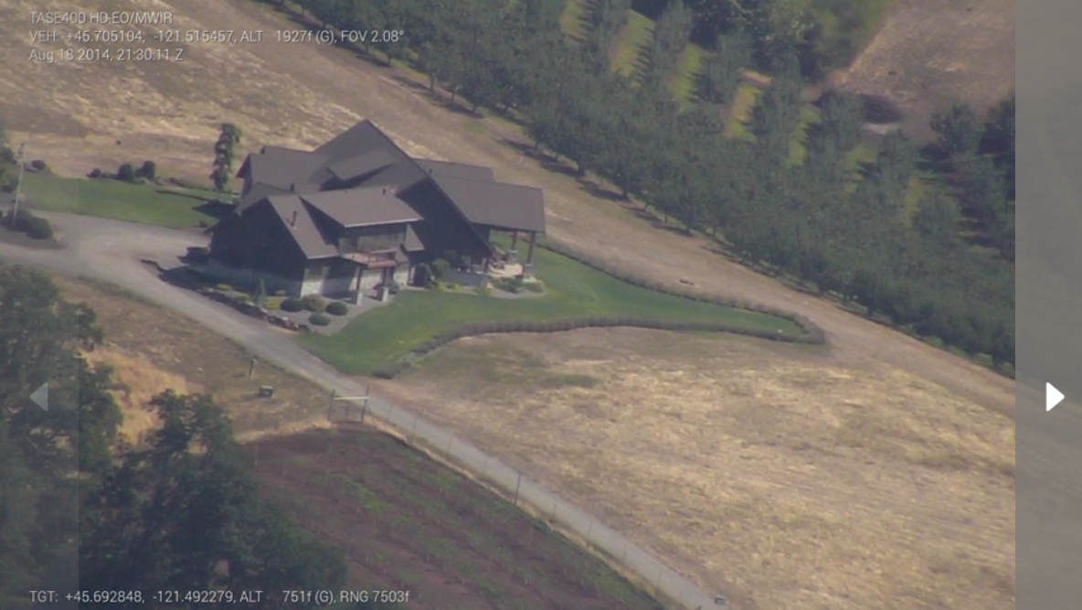
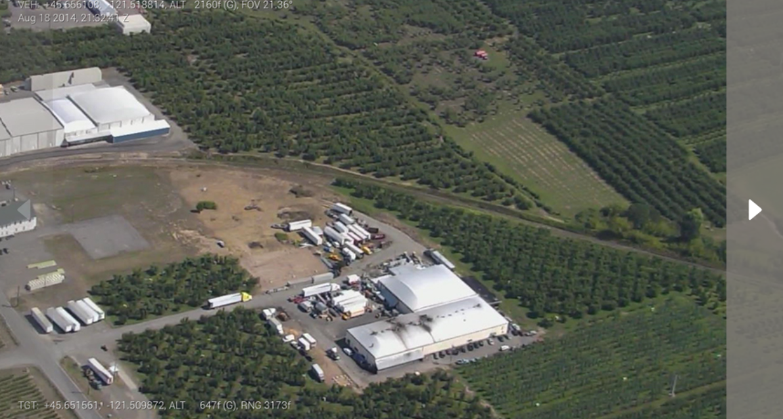
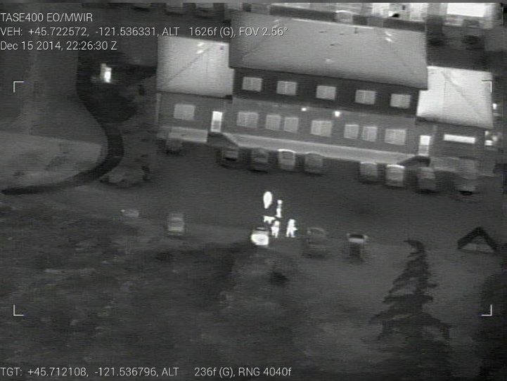
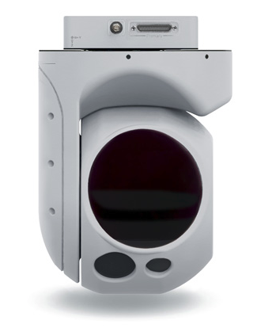
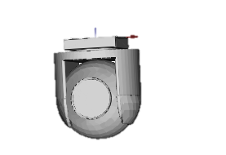
Full Motion Video
Size | 6 in dia
Weight | 9 lbs
Pointing Accuracy | 1.5 deg
Video Format | h.264
Video Metadata | MISB Compliant KLV Metadata
EO
GSD (200m Slant Range) | 0.10 m
GSD (1000m Slant Range) | 0.45 m
Frame Rate | 30 fps
MWIR
GSD (200m Slant Range) | 0.50 m
GSD (1000m Slant Range) | 0.80 m
Frame Rate | 28 fps
Separate FMV turrets for either Day or Night capability
Rapid installs (<5 minutes) enable day/night capability
Identical form factor, size, weight and power.
Training Note: This sensor was inspired by CloudCap TASE series sensors, but is completely notional for training.

Slide 5
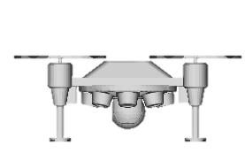
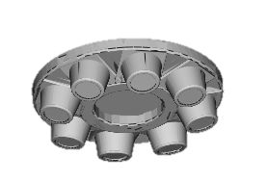
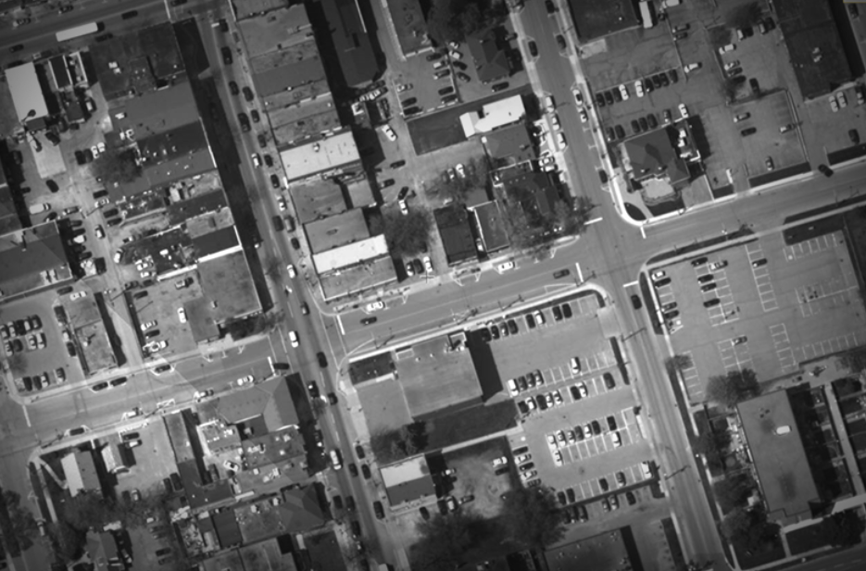
Bluefire Wide Area Camera
4 images are taken simultaneously and sent to the ground station, where they are stitched together into a single image
Weight | 12 lbs
Coverage Area (200 ft AGL) | 380,000 sq ft
Image Format | NITF Compliant JPEG 2000 Compressed
EO
GSD | 0.40 m
Latency | 1.8 seconds
Frame Rate | 2 fps
Low Light
GSD | 0.60 m
Latency | 2 seconds
Frame Rate | 1.5 fps
Can operate in either manual or automatic mode
Automatic mode sends images down constantly beneath the vehicle – used for overwatch or survey
User selectable day (electro-optic) or night (low light cameras)
Training Note: Image from Pixia website, not representative of real capability https://www.pixia.com/solutions/hiper-stare/

Slide 6
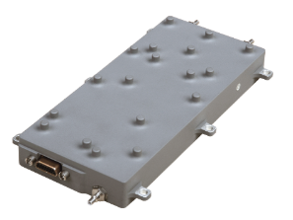
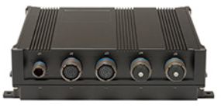
Mission Computer and Communications
Hardened Single Board Computer
Runs all mission processing applications
Health Monitoring
Product re-transmission
Increased Storage Capability
Capable of storing 1100 wide area images, or
95 minutes of video
Sourced from US company
Encrypted at rest
Advanced lightweight tactical datalink
Capable of operating in Ku, L, S and C bands
Data rates up to 40 mb/s
Range up to 15 nautical miles
FIPS 140-2 Complian Encryption
Weight | 1 lb
Processor | Quad Core Intel Processor
Storage | 250 GB Solid State
RAM | 8 GB
Training Note: Image from MPL website, https://www.mpl.ch/t2401.html/
Training Note: Image from L3 Website
https://www2.l3t.com/csw/products/airborne/bandit.htm

